Slide 1
Content and description panes default values in the Alma Viewer
Yoel Kortick
Senior Librarian

Slide 2
Content and description panes default values in the Alma Viewer
Configurations under "Configuration -> Viewer Services -> Alma Viewer" allow collapsing information panes by default.
By making the default “collapse” there is more room on the screen for the appearance of the digital files.
Users can manually expand and minimize the panes.

Slide 3
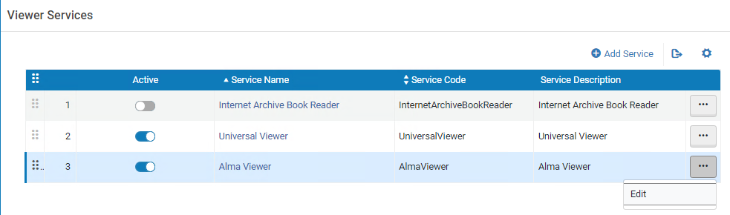
Content and description panes default values in the Alma Viewer
"Configuration > Fulfillment > Discovery Interface Display Logic > Viewer Services > Alma Viewer > Edit"

Slide 4
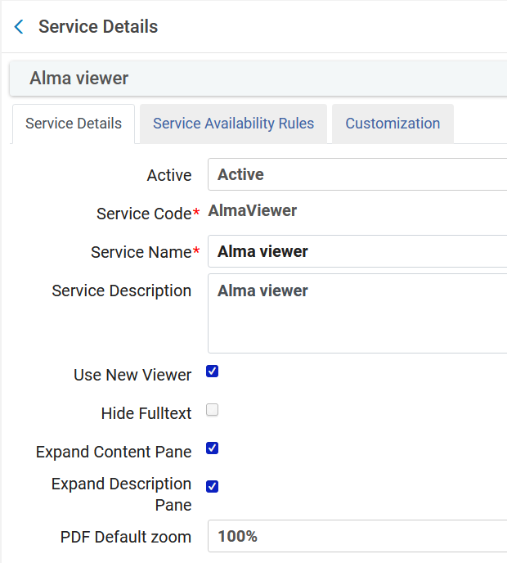
Content and description panes default values in the Alma Viewer
Currently both ‘Expand Content Pane’ and ‘Expand Description Pane’ are checked.

Slide 5

Content and description panes default values in the Alma Viewer
We will view the digital objects for title ‘Gloria Steinem’

Slide 6
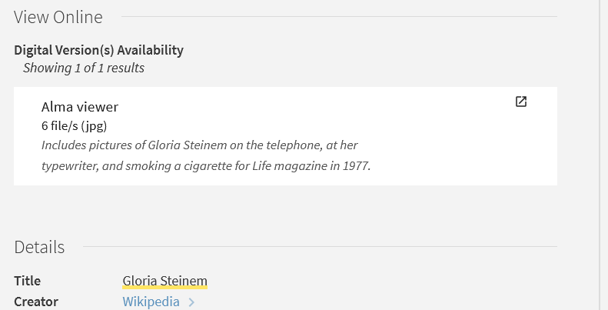
Content and description panes default values in the Alma Viewer
We will view in the Alma Viewer

Slide 7
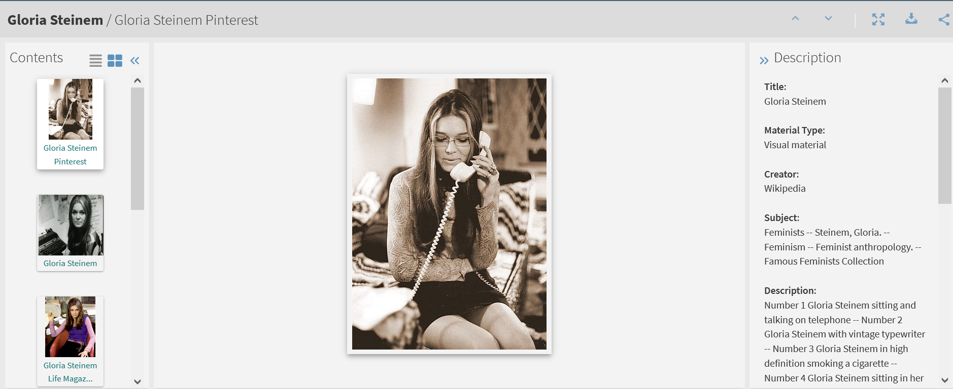
Content and description panes default values in the Alma Viewer
The Contents Pane and Description are by default expanded

Slide 8
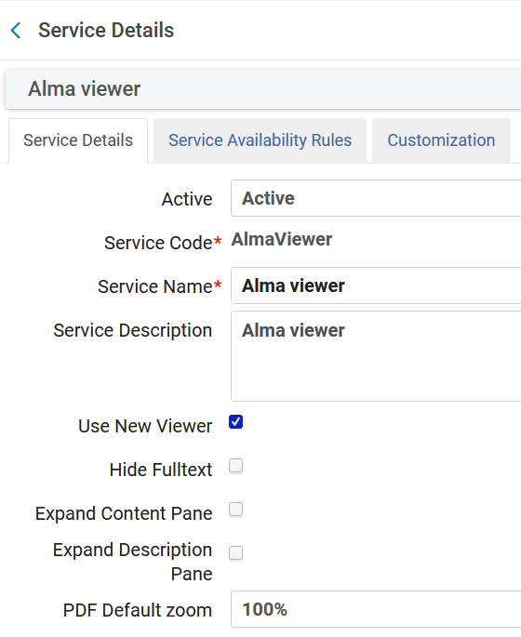
Content and description panes default values in the Alma Viewer
Now we have unchecked both ‘Expand Content Pane’ and ‘Expand Description Pane’

Slide 9
Content and description panes default values in the Alma Viewer
Again, we will view the digital objects for title ‘Gloria Steinem’

Slide 10
Content and description panes default values in the Alma Viewer
Again, we will view in the Alma Viewer

Slide 11

Content and description panes default values in the Alma Viewer
The Contents Pane and Description are by default minimized

Slide 12
Content and description panes default values in the Alma Viewer
At any time, the user can expand and minimize the panes
Expand panes here
Expand panes here

Slide 13
Content and description panes default values in the Alma Viewer
At any time, the user can expand and minimize the panes
Minimize panes here
Minimize panes here

Slide 14
xxx@exlibrisgroup.com

